Slide 1
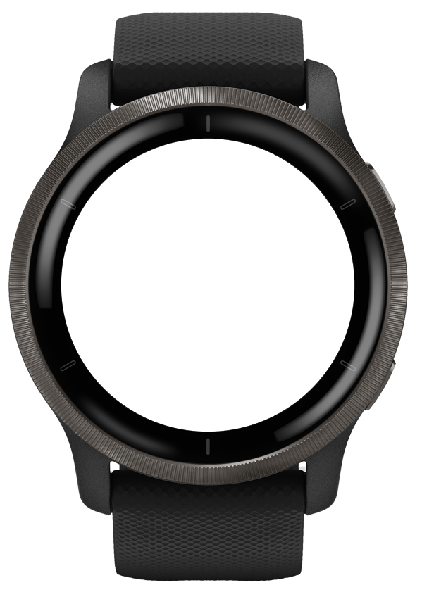
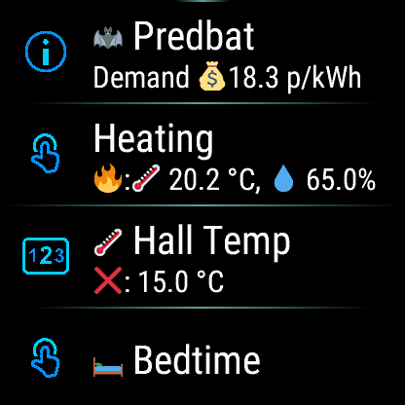
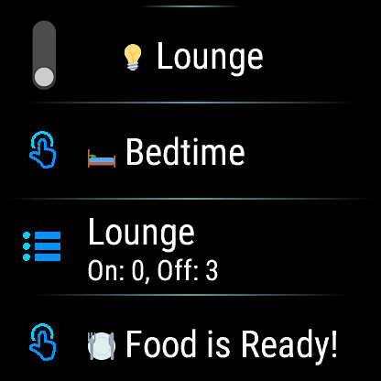
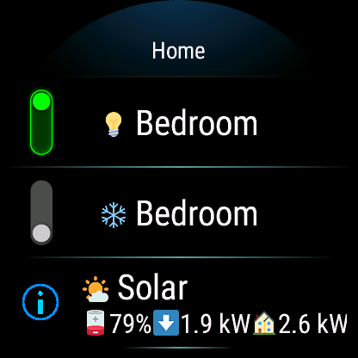
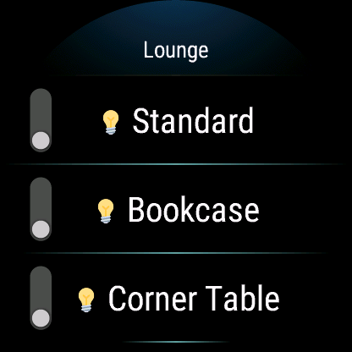
Toggle switches
Amend Numeric Values
Trigger Automations
Sub-menus
HomeAssistant for Garmin

Slide 2

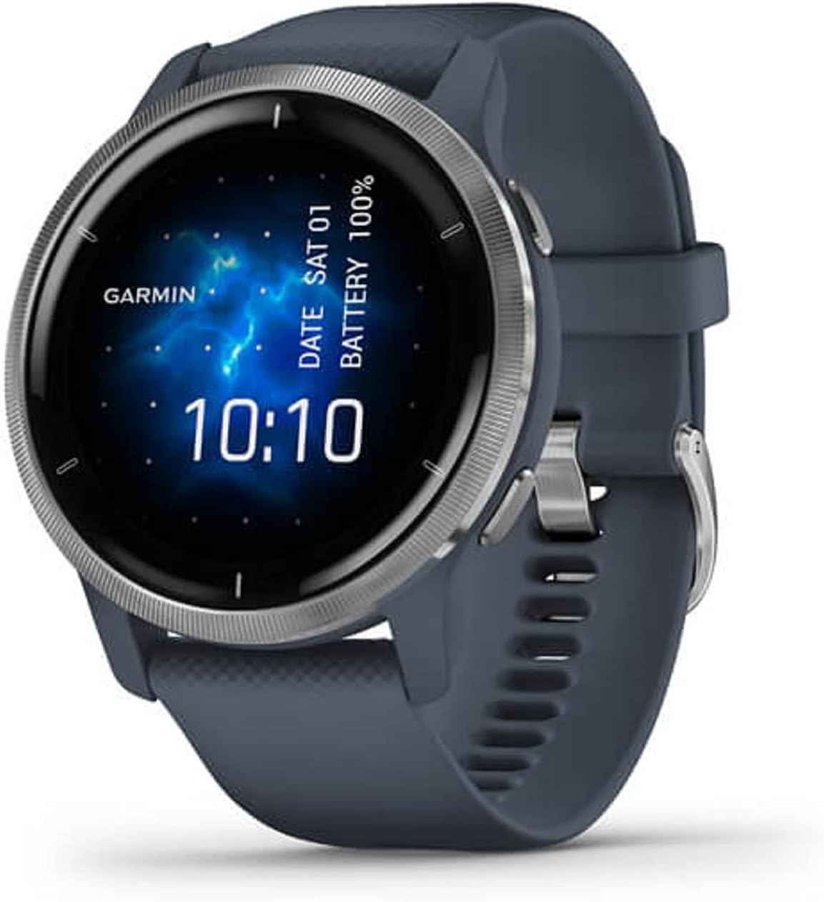
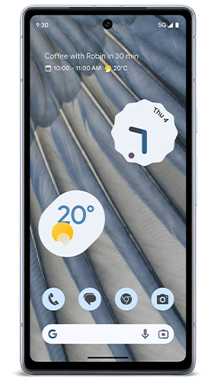

Home Assistant Setup
Admin: http://<private_url>:81/login
Mobile / Wi-Fi
Bluetooth
Broadband
HTTPS
HTTP
Raspberry Pi
Proxy
Web Server
https://<public_url>/
https://<private_url>/
Dynamic DNS
<public_url> -> router IP address
http://<private_url>:8123/
Router:
Port forwarding 443 to Private LAN Home Assistant IP
Port forwarding 80 to Home Assistant IP for Let’s Encrypt.
Menu: https://<public_url>/local/garmin/menu.json

Slide 3
Nabu Casa Setup
Admin: https://account.nabucasa.com/
Mobile / Wi-Fi
Bluetooth
Broadband
HTTPS
HTTPS
Nabu Casa
Raspberry Pi
Web Server
https://<id>.ui.nabu.casa/api
Menu: https://<id>.ui.nabu.casa/local/garmin/menu.json
http://<private_url>:8123/

Slide 4


